Slide 1
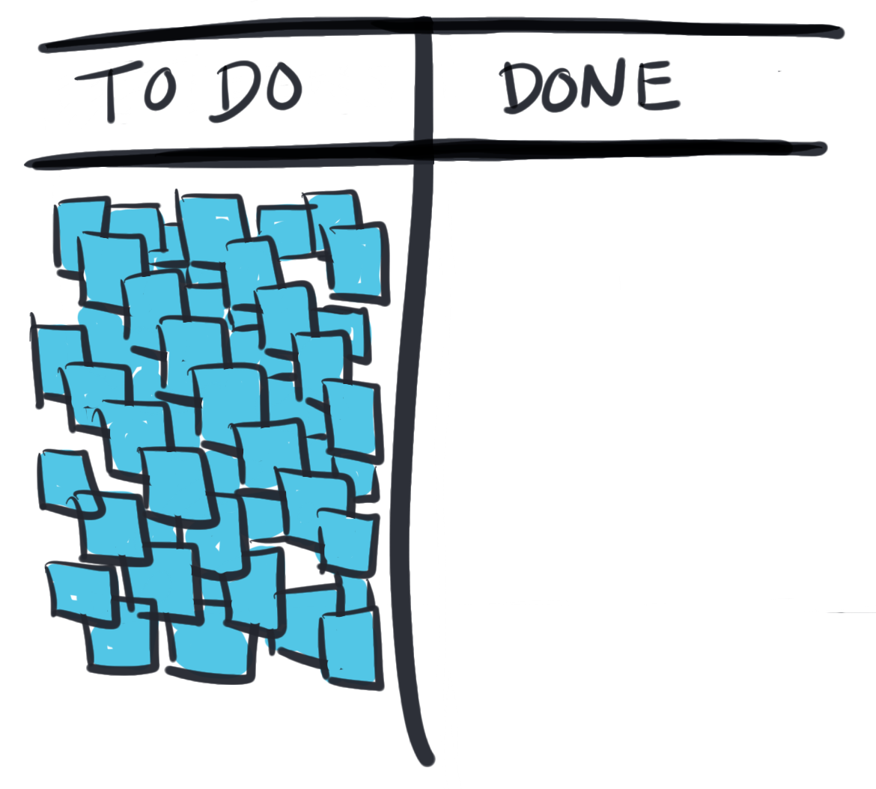
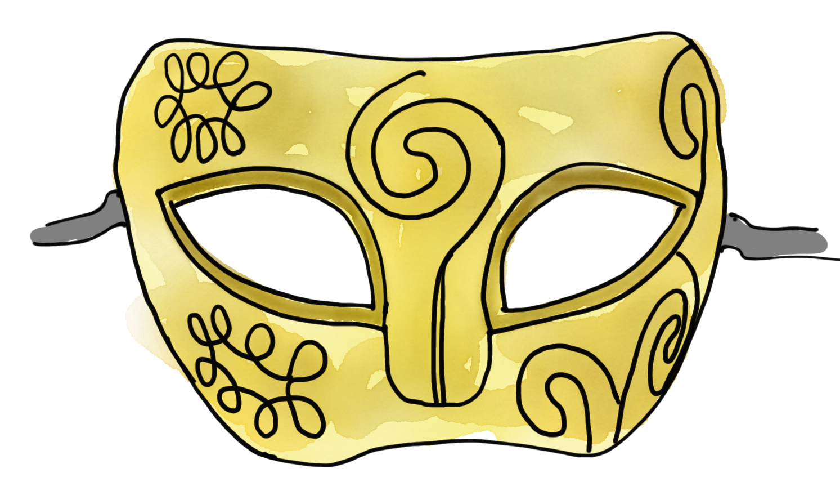
Making Work Visible – How to Unmask Capacity Killing WIP
Dominica DeGrandis
Executive Consultant
@dominicad
Notes:
Hello Evry – nice to see you all here today! plsre for any years now, to help ppl make work viz. I help teams (shapes & sizes) dscvr how to see t/ things that prevent them from dlvrng work. AND I help them design Kanban systems to optimize their workflow. It's the work that I love the most! Today, talk 3 things

Slide 2
A look at three things
Why are we really so overloaded?
How to unmask the overload
Kanban designs that can bring visibility to the things that kill capacity.
@dominicad
Notes:
Why are we really so overloaded? 2. How to unmask the overload that prevents us from finishing important work. 3. Share some Kanban designs w/ you that can bring visibility to the things that kill a teams capacity to complete Work-in-progress or WIP for short.

Slide 3
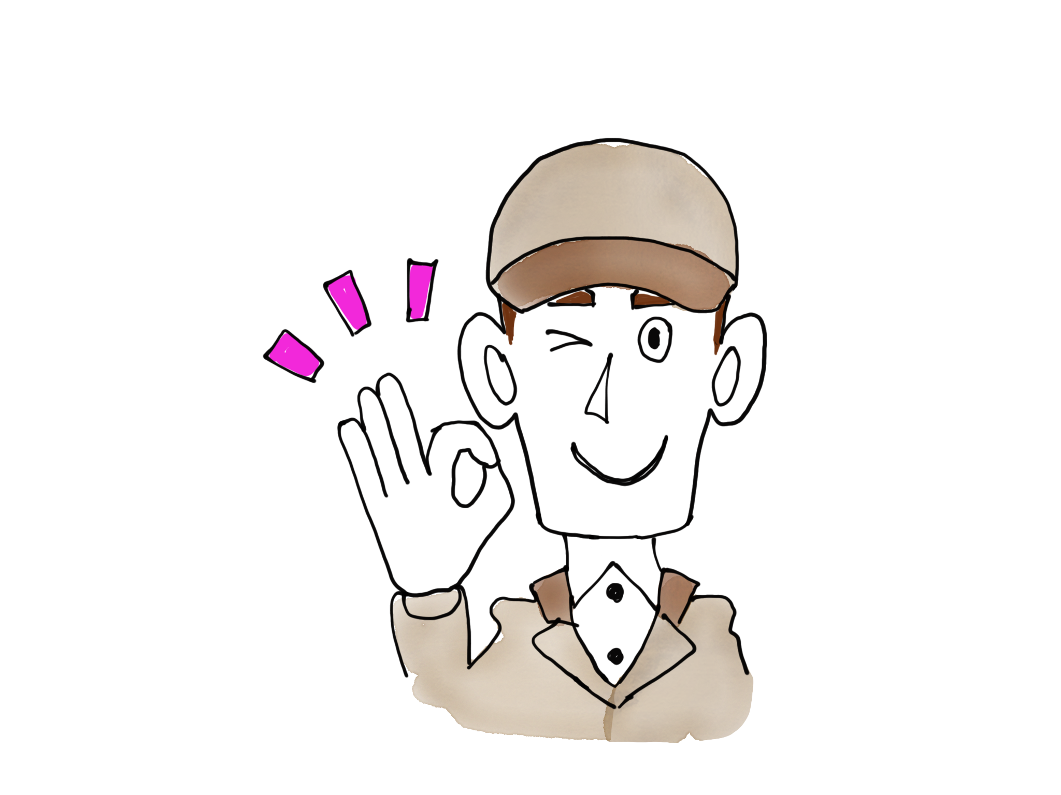
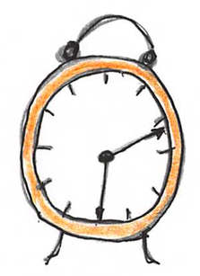
Why do we think we can finish things faster than we actually can?
Tend to underestimate # distractions
yes to requests that we should decline
Notes:
1st off, Why are we so overloaded? Why …
We underestimate # disruptions that sidetrack us from focusing on the work and finishing it on time.
We tend to say yes to requests we should prolly decline, or at least postpone.
Before we know it, it’s 2:30 pm Sun, instead of spending time w/ fam/hobby, we’re working on thing due Mon at 9 am.
Why overload to pt of Sun, new Mon? B/C…

Slide 4
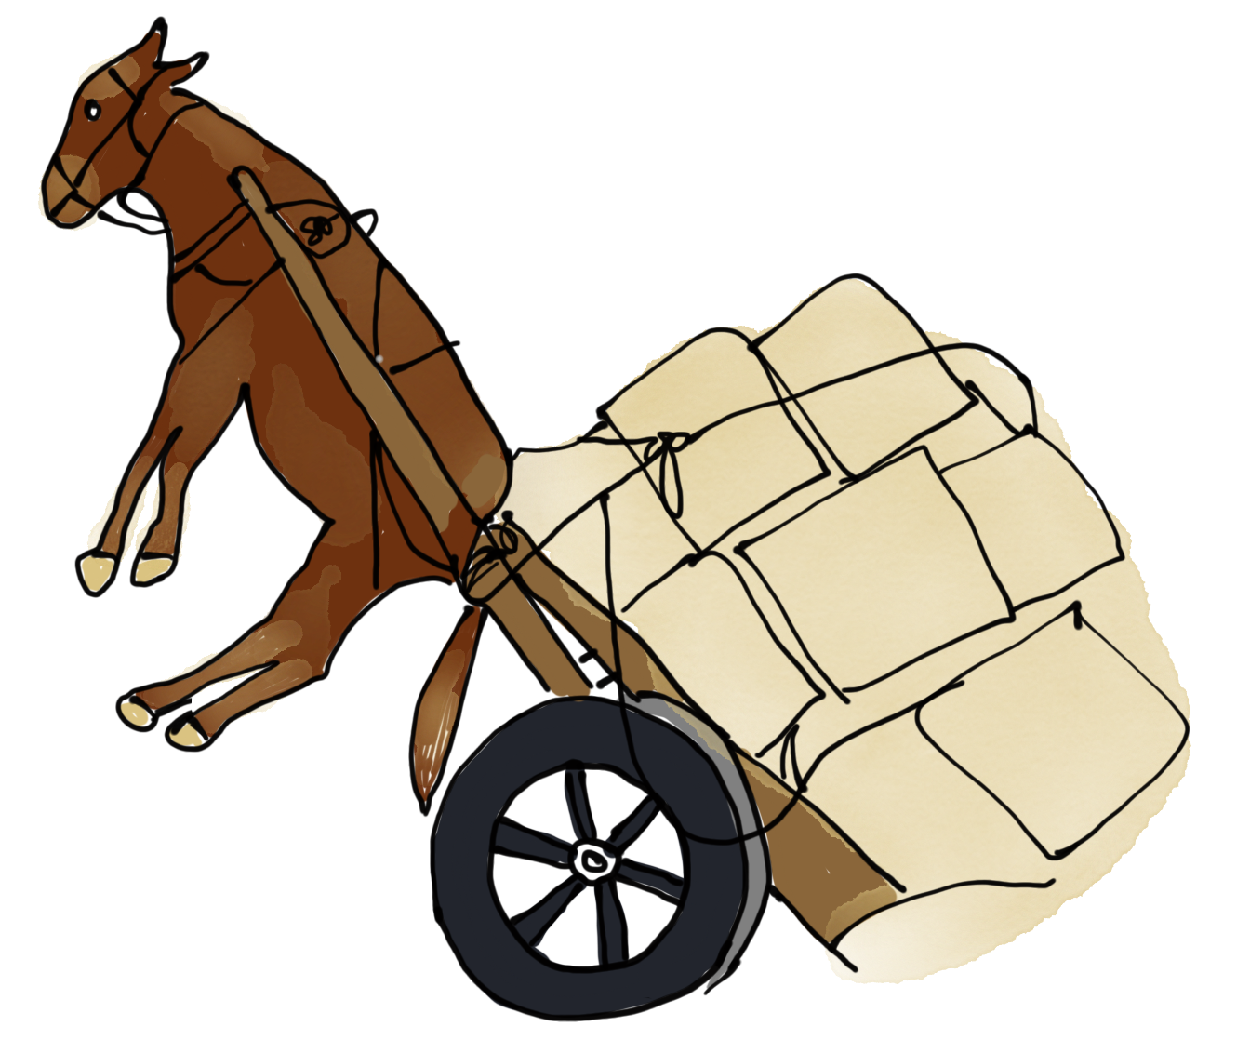
Sometimes burnout cultures play a role, but ….
Many of the reasons why we’re overwhelmed starts with our own doing.
Why do we say yes to doing more work than we have capacity to do? 4 reasons
Notes:
B/C.. When someone asks us to do something, we say ____? Yes! We take on > wk than can complete dsrd TF.
Sometimes burnout cultures do play a role…. But often do it ourselves. Why do we say yes to doing more work than we have capacity to do?
Argue 4 reasons:

Slide 5
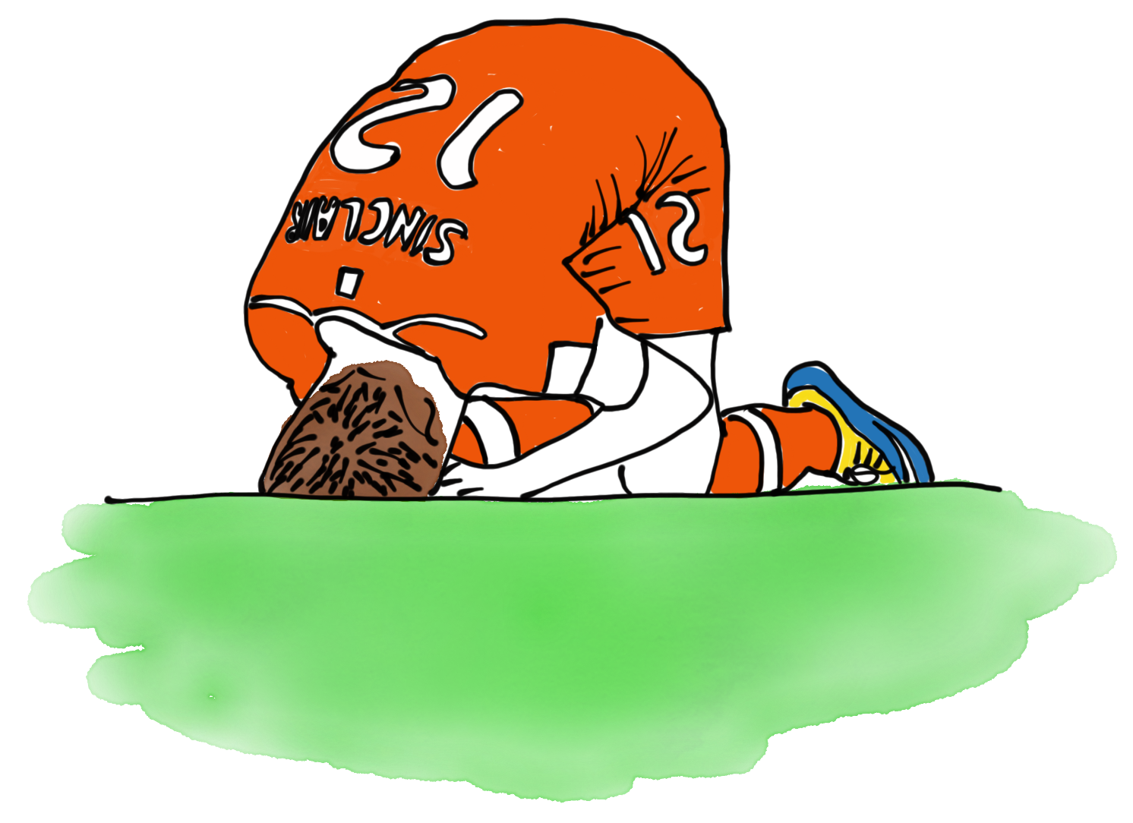
#1 - I don’t want to let the team down.
Notes:
#1 No one wants to be person rspnsbl for team losing. We con’t to say yes to new work BC we believe it will help us win – help team look smrt & cpbl
Ex:

Slide 6
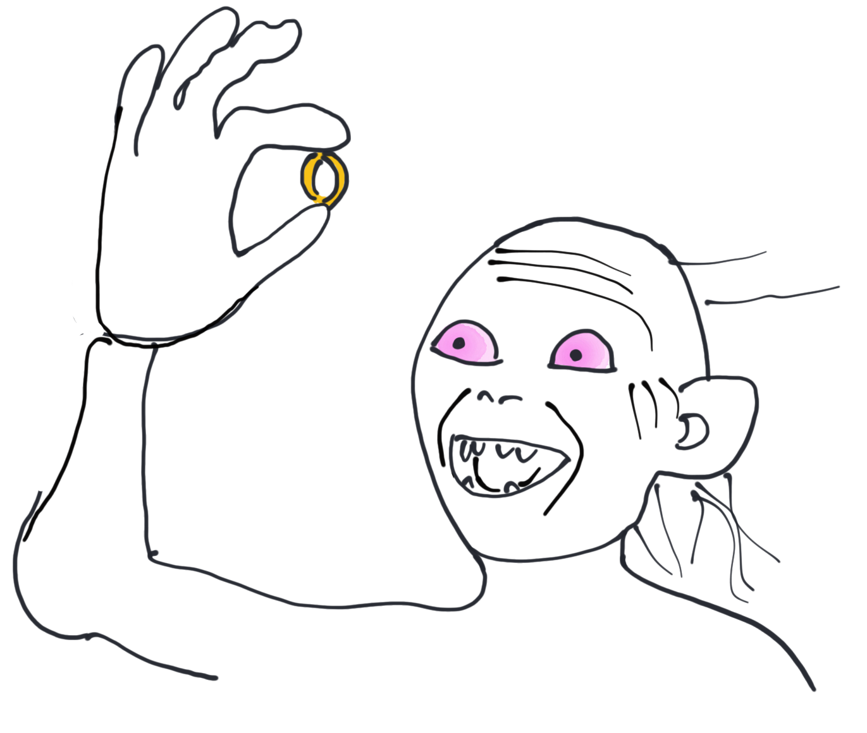
#2 I’d rather start a shiny new thing than toil in something unglamorous.
optimize for fun
Notes:
#2 Shiny new object syndrome: Starting smthng new & shiny more enjoyable than doing grunt work tks to finish older, unglamorous work. ex: Implmntng new microservices usng Dckr cntnrs might be > stsfng thn security audit. I call that “Optimizing for fun.”
What do for Dinner?: fine dining restaurant w/ prime rib & farm fresh veggies vs. eat 3-day old tuna casserole.

Slide 7
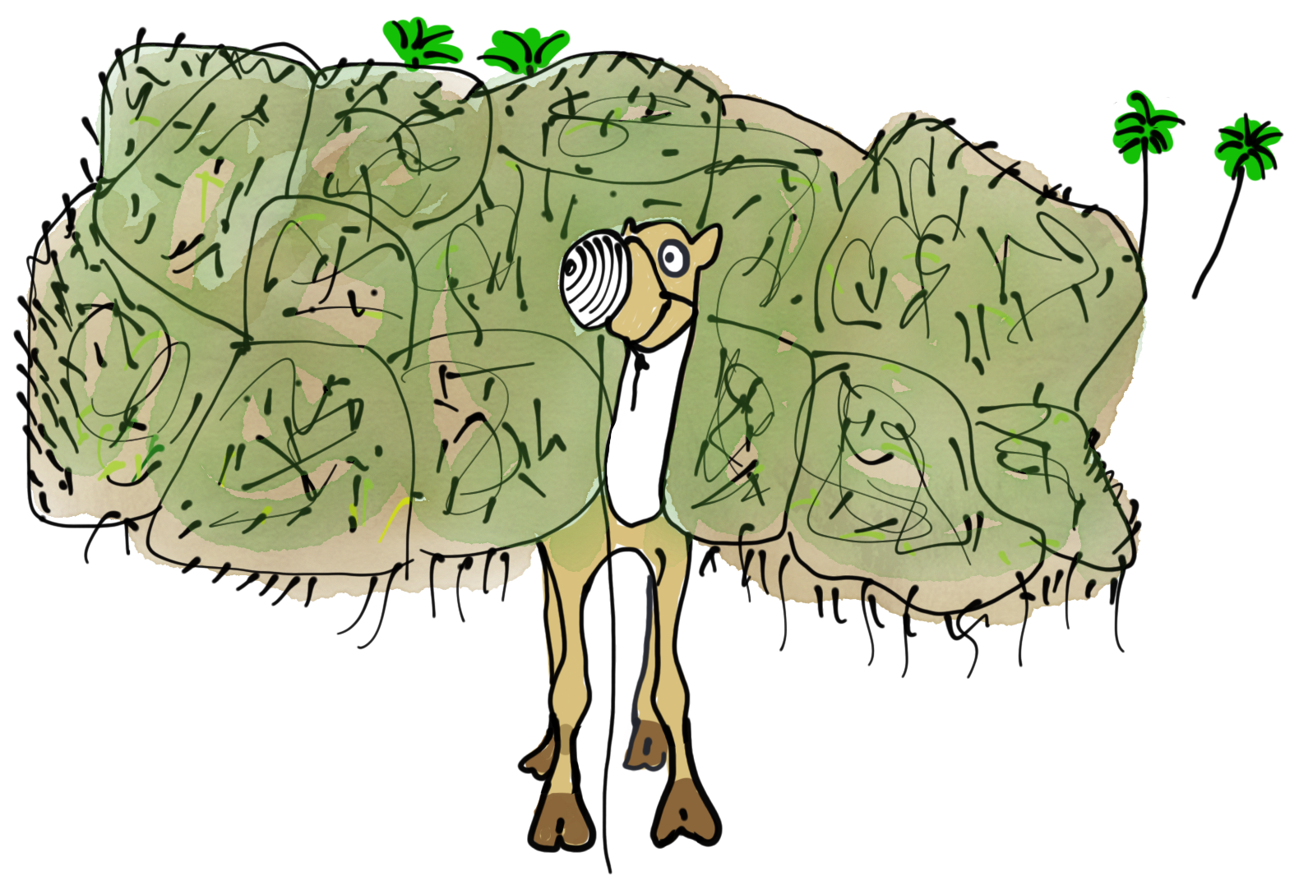
#3 I Didn’t realize how big the request was.
Notes:
#3. Everything always always takes longer than we think it ought to. Especially other people’s work. Ex: ?
Ex: I thought I could write book in 6, but it taken me over a year.

Slide 8
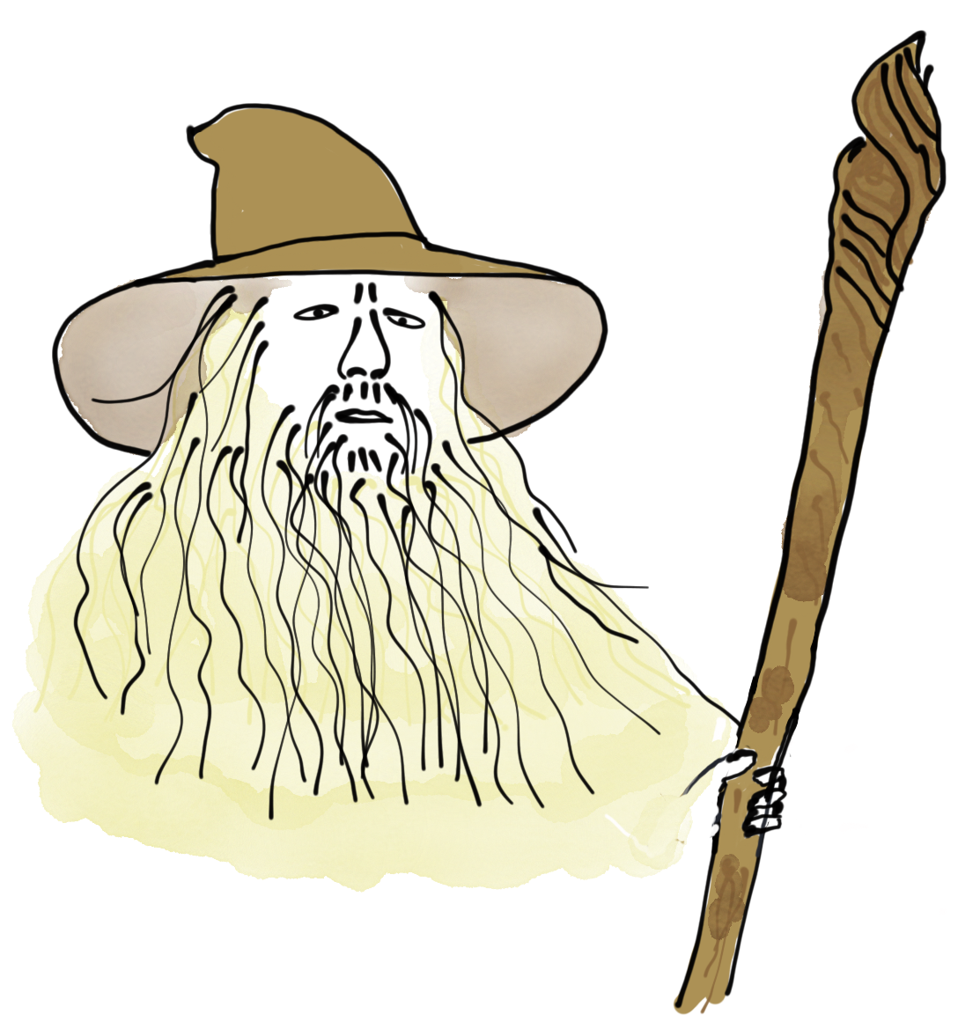
#4 The boss asked me.
It’s hard to say “no,” to the boss or to people we like.
Who feels okay to refuse a manager’s request?
Notes:
R#4: “Yes” is easier to say than “no,” esp to t/ boss or ppl we like. As an exec consult, I train/coach a lot customers on Lean Kanban flow and it’s not unusual for ppl to reveal their worry abt being let go. Sometime boss asks for SB–> and they feel can’t say no. SB is a special 1-off request - Hey, join this call to talk abt a new microservice, or temp manage team X. SB sneak in, shouldn’t take long. To clarify, not blaming boss – just like everyone else, thinks it won’t take long. Like prev slide – Don’t realize. When we take on more work than we can finish in the time we thought possible, we don’t just overload ourselves, we overload our teams.
To chg behavior, it’s helpful to look at some practices found in a mature DevOps culture.

Slide 9
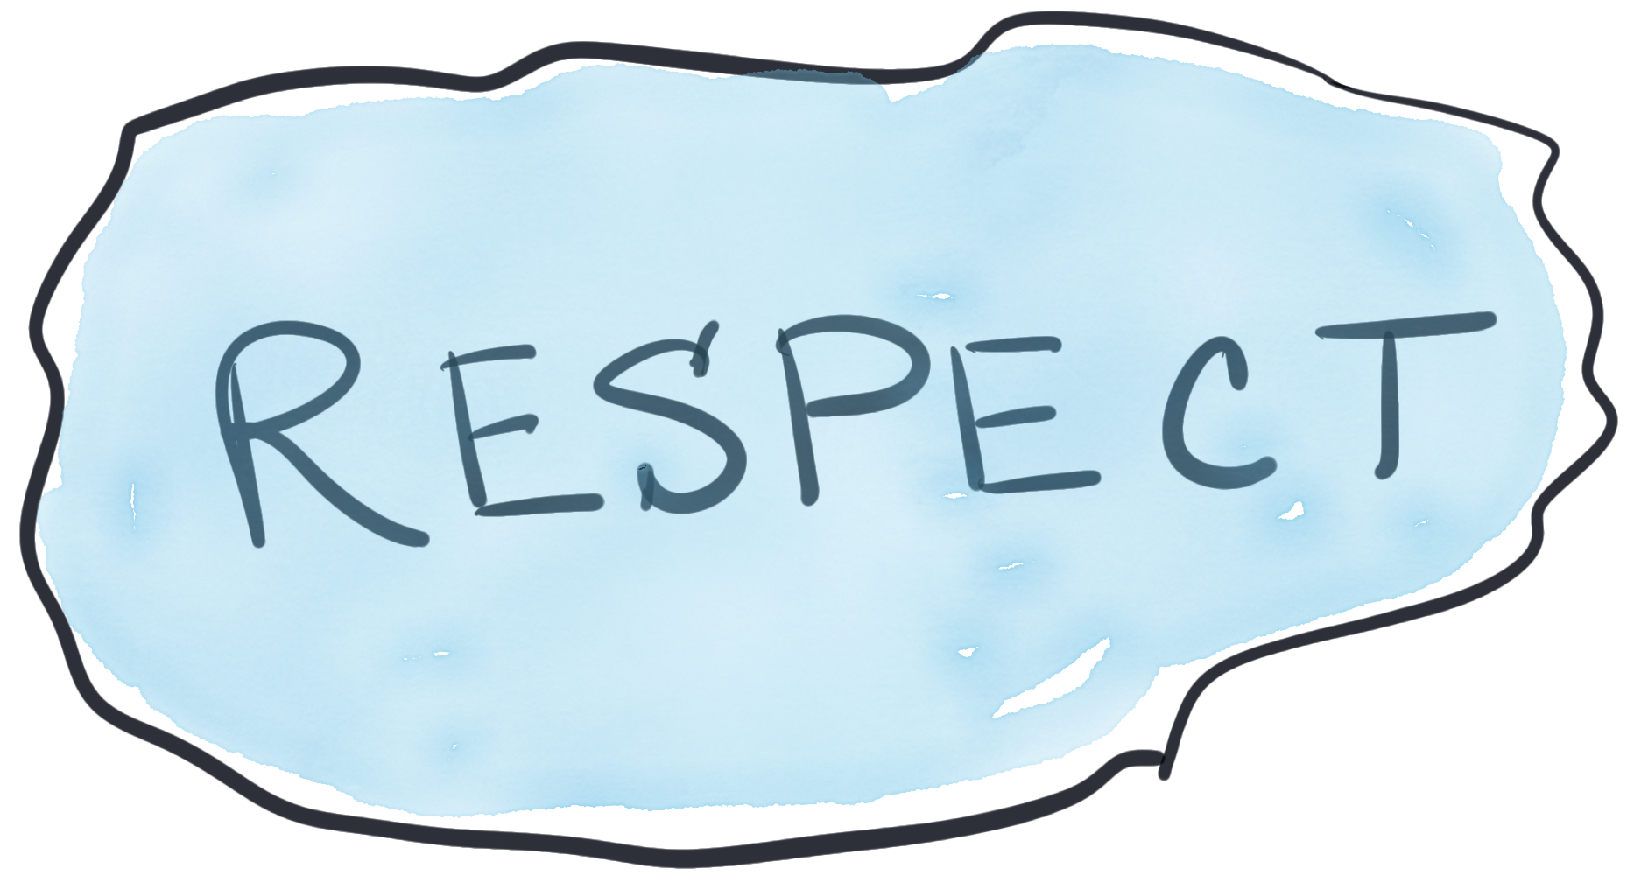
Enter DEVops Culture
information flow
the value of learning
high cooperation & trust
people like their job
➔
Notes:
ex DevOps culture where info flows across org, ppl not blind sighted. The Climate for Learning is considered an investment – not just a cost. high cooperation & trust, ppl like their job. If look at attributes, all require a level of Respect f People, which is rooted in Lean. Many DevOps practices emerged from t/ Lean mvmnt: continuous improvement, systems thinking, value streams, creating value for t/ customer, and respect for everyone. It’s these attributes that embody the “Lean” house.

Slide 10
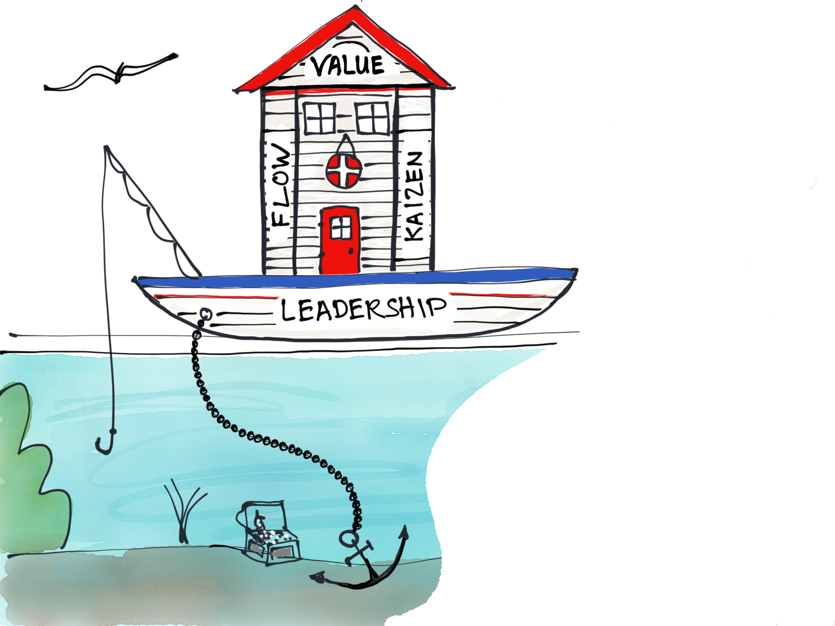
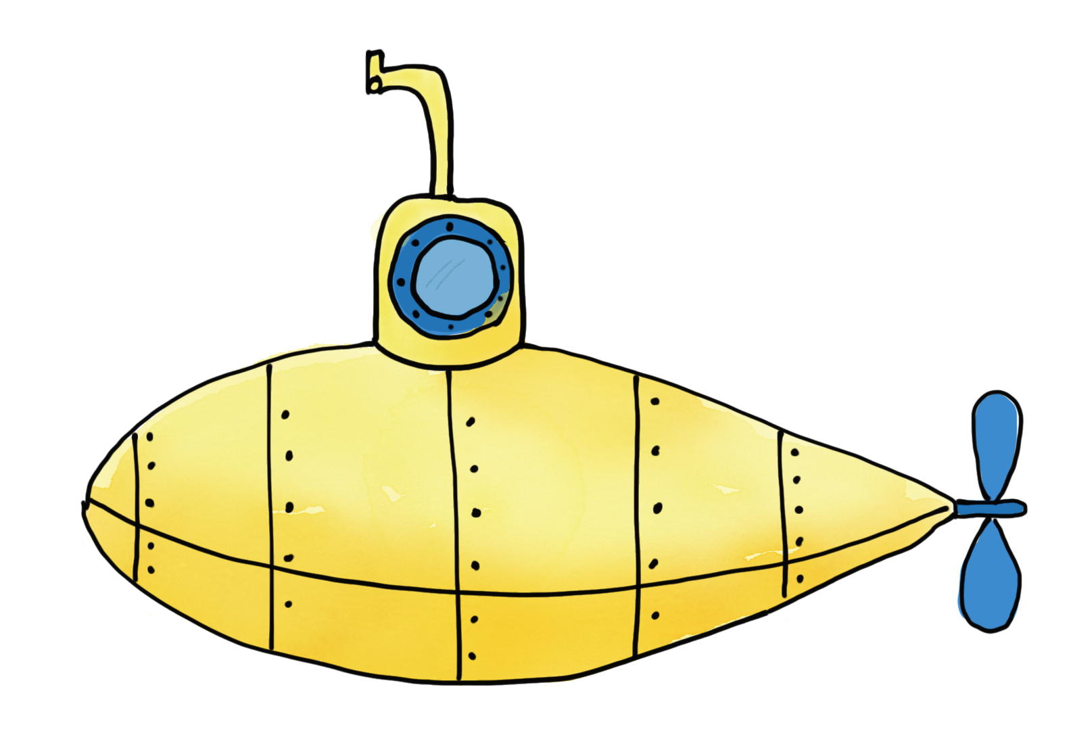
THE LEAN HOUSE
Respect for people
Leadership
Continuous Improvement
Value
Flow
Pay attention to this visual cue
Notes:
b/c DOES theme dive deep, Lean boat house. Respect for ppl is Lean pillars. RFP = honesty when speaking w/ others vs. remaining quiet to avoid conflict. Being truthful w/ feedback. It’s this respect for ppl that provides t/ leadership foundation of safety for ppl to be honest, which enables con’t imprvmnt, which in turn help to deliver customer value quickly. Con’t w/ t/ DOES dive deep theme – yellow subm – sprinkled thruout prez as visual cue to pay special attntn to slides w/ extra good learning tips. Other pillar of Lean is FLOW. Implementing FLOW sets t/ stage for implementing DevOps. 1 big ecosystem.

Slide 11
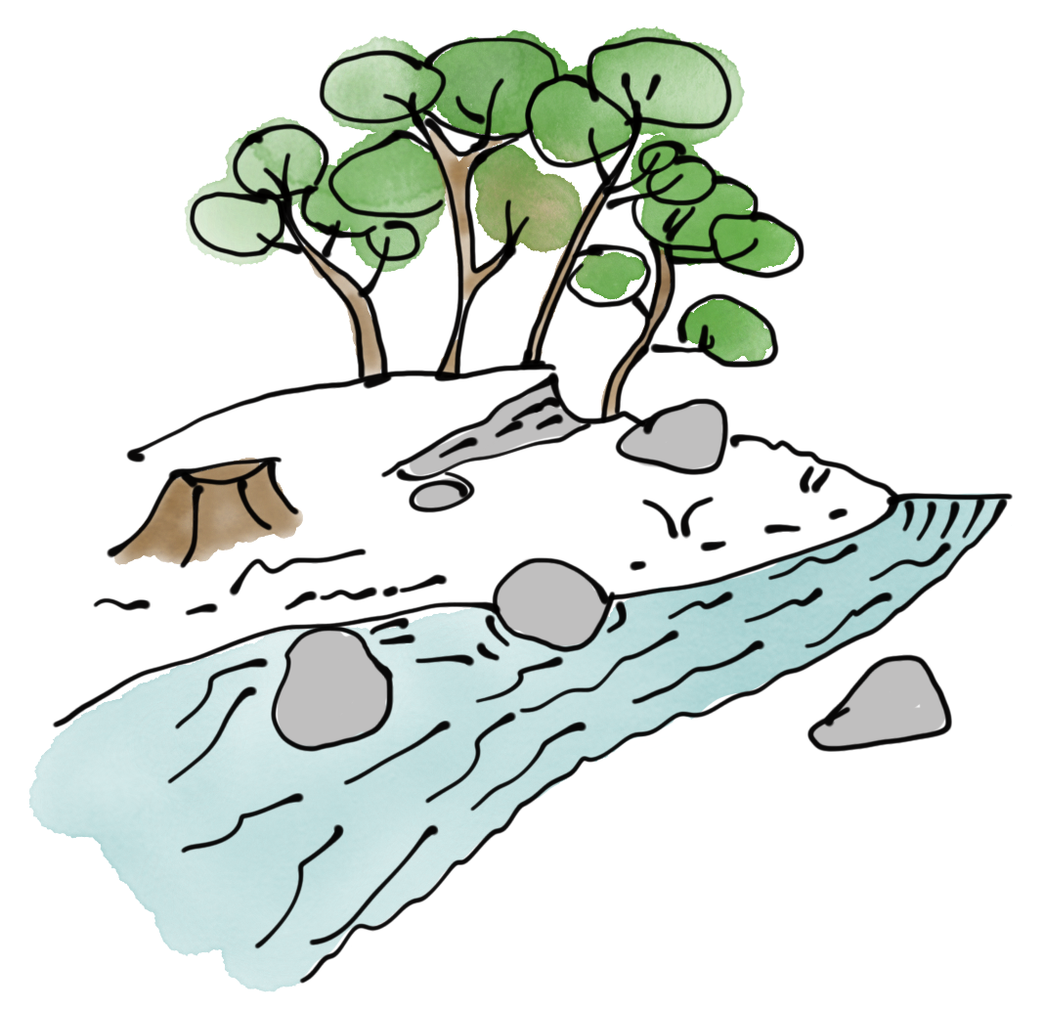
Continuous smooth & fast FLOW of customer
value makes for happy customers.
The biggest deterrent to FLOW is too much WIP
Value Stream - the activities done from beginning to end for a specific product or
service in order to provide business value.
Notes:
What is Flow? Fast & smooth FLOW of work fr t/ business request all t/ way across t/ VS to prod is how we can deliver value quickly to customers. By VS = …. Speeding up t/ FLOW of work through t/ VS, delivers value faster.
FLOW speeds up by: MWV, reducing batch size, building quality in. This talk focuses on MWV. The biggest deterrent to FLOW is too much WIP. Why is that?

Slide 12
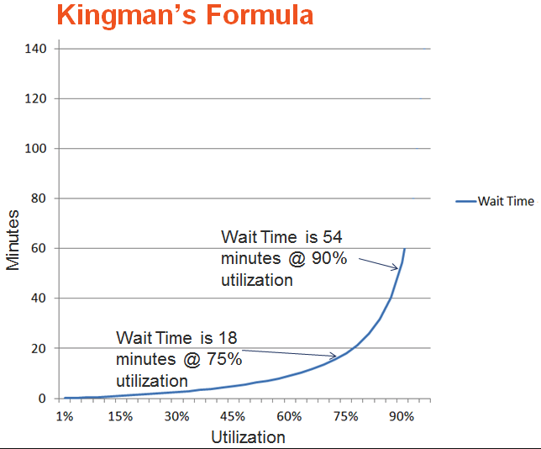
Why Too much WIP deters flow
“I’m sorry, but
all our agents are
busy at the moment.”
WIP & Flow time have a relationship
https://www.leancompetency.org/lcs-articles/the-equation-of-lean/
https://leanlaborstrategies.com/2013/12/13/those-office-workers-have-it-made/
Notes:
B/C >WIP scatters our attention across multiple things, and interruptions, which causes context switching, This causes people (like customers waiting on hold for an agent) to wait longer than they’d like to be helped. >WIP sabotages our ability to deliver work on time.
I worked w/ an Ops team in LA that had 41 engineers (sys admin, DBA, network engnrs, 33 projects, bldg 6 DC, 6 diff countries, on top of carrying the duty pager. Slow to respond to biz requests, lost respect fr other teams. biz circumvented them, outsourced requests to get their needs met.
When you start work faster than you finish it, it doesn’t just affect your current projects; WIP & Flow time have a rltnshp. Queuing Theory behind this - Kingman’s formula Ex shows how wait times increase dramatically as utilization approaches 100%.
Flow time is a word I use to mean the duration of the elapsed time it takes work to flow thru the system. Some people dogmatic abt the exact definition of CT & LT & I don’t want to get caught up in where in the value stream the clock starts ticking– it depends on your context. The important point here, is that High WIP=high wait times BC other items sit waiting for attntn.

Slide 13
WIP is the leading indicator
that your FLOW is congested.
33 boats moving through a canal at one time makes for a long wait.
Notes:
This why the primary factor of FLOW time is the amount of work-in-progress. It’s what makes WIP is a leading indicator. You know when 10 airplanes are trying to fly out at the same time. The line is long. Same thing for boats at a canal. You don’t have to wait until the planes take off or the boats finish going thru the canal to know that it’s going to be a long wait. So, now that we know why ppl take on >WIP and why biggest deterrent to FLOW is >WIP, let’s talk abt what to do abt it.

Slide 14
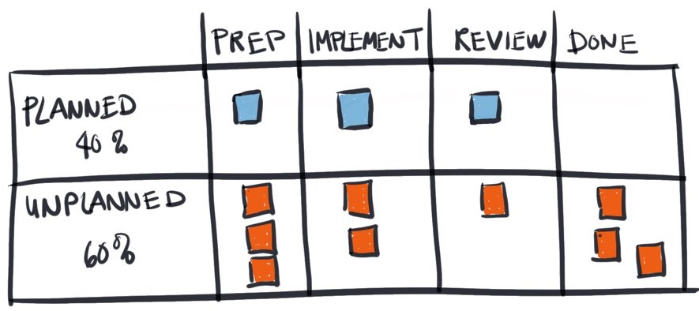
How to Unmask WIP overload
Map out workflow to see where work gets stuck..
Partially completed work is expensive – make it visible to provoke conversations on how to speed it up.
Notes:
Design a Kanban system so you can map out your workflow. Here’s a basic example of a kanban board. There are many diff ways to approach a kanban board. They won’t all the same – depends on your context and what trying to accomplish. This design brings visibility to the amount of planned work vs. unplanned work, prolly b/c unplanned work prevents the planned work fr flowing faster. Partially completed work is expensive, so it’s important to understand what makes it move faster, and what’s causing it to be stuck. Will talk more on unplannd wrk in a bit.

Slide 15
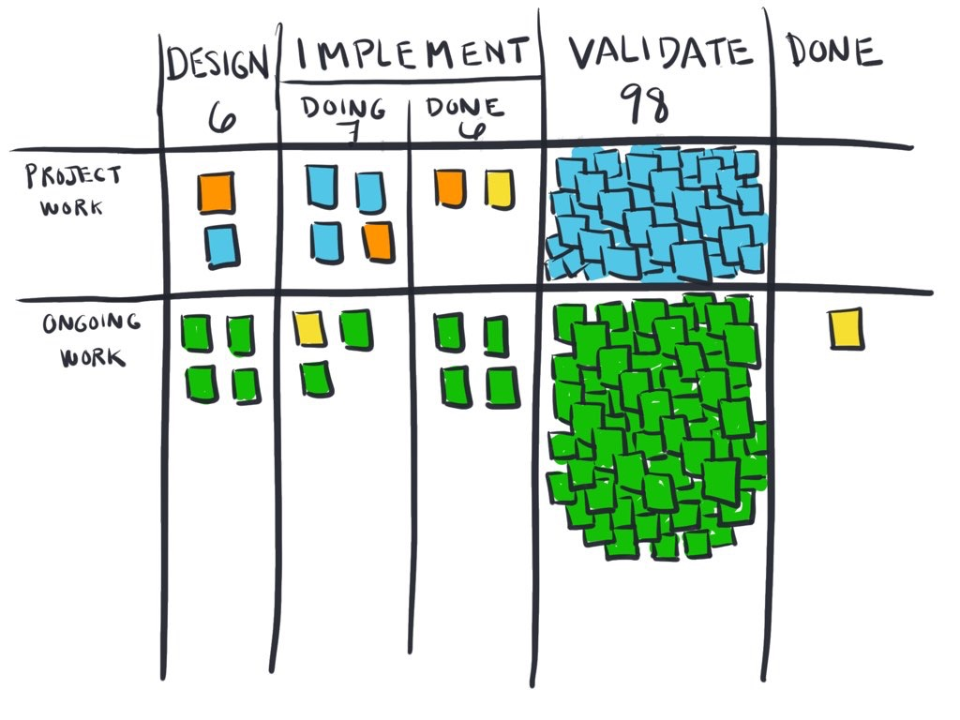
Improve Flow by making work visible
Notes:
When the state of work is viz, you can see the problems, such as where work is stuck. Where is work stuck here?
This 1 is obvious. When you see work pile up, it should provoke a conversation abt what to do about it. How can we avoid work getting stuck in validate? If you don’t have this capacbility yet, then just query your ticketing or workflow system – show everythg > 30 days. If cards are marked w/ priority or other tags to show value, then better.

Slide 16
“Why is this expensive piece of business value stuck?”
Notes:
When you notice work on board is stuck, consider the investment needed to finish the work, compared to the value that will be gained.
If it’s important valuable work, get it flowing again by asking, “Why is this expensive piece of business value stuck?”
I’m going to argue that your expensive piece of business value isn’t moving, because it’s competing with one or more of the following obstacles:

Slide 17
1. Unplanned work 2. Conflicting priorities 3. dependencies
Start With finding constraints
Notes:
These are some of the biggest impediments to FLOW.
Let’s take a closer look at these.

Slide 18
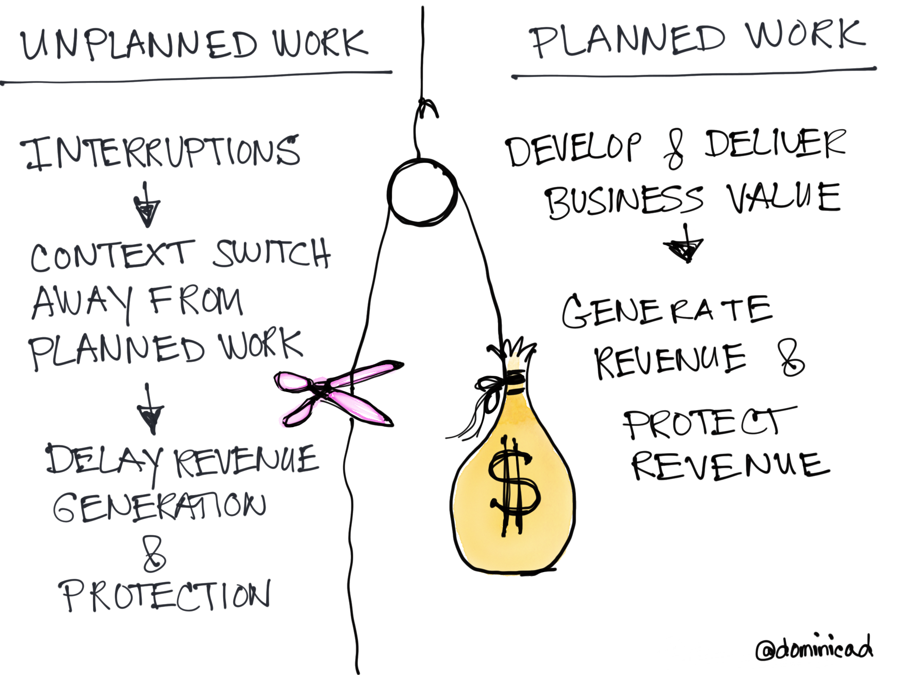
#1 Unplanned work
#1 Unplanned work
Notes:
Unplanned work inclds prod issues & other unexpected incidents & requests. If your provider goes down, the team stops working on what they were doing work and starts troubleshooting. This cuts into FLOW of planned work, which delays planned business requests that generate revenue or protect revenue, or depending on your business, to deliver goals outside of revenue.

Slide 19
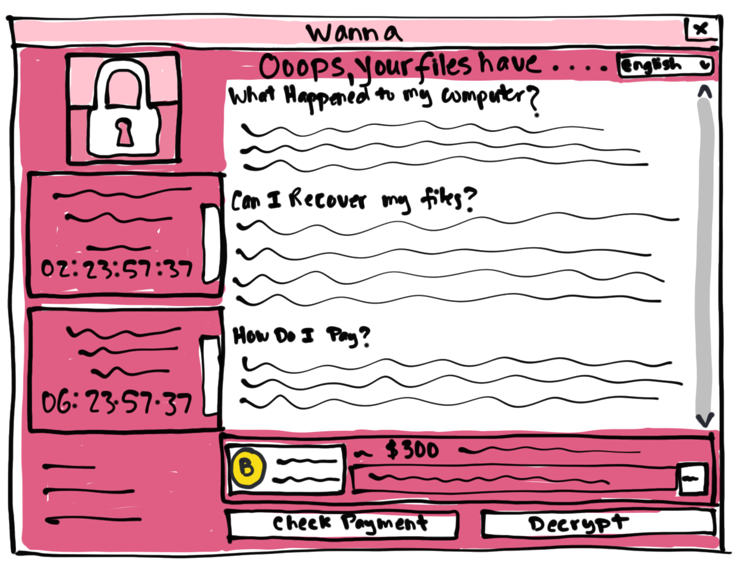
Plan for Unplanned work
Uncertainty abounds in this world. It will always exist, so plan for it. Put yourself in a position so that unplanned work won't kill you.
Completed maintenance reduces unplanned work.
Notes:
There are things you can do to put yourself in a better position so that unplanned work won't kill you.
Ex: Regular maintenance reduces unplanned work. Organizations with fully updated systems were largely protected from the WannaCry ransomware attack. Early and often merging of code to the mainline reduces broken builds that cause havoc.
Regular cleaning of ditch drains in Seattle helps to prevent basements from flooding.
Pull a maintenance card or two onto your Kanban board to ensure that some of your team’s capacity is committed to regular maintenance.

Slide 20
To do
doing
validate
done
Unplanned
work
Planned
work
Maintenance
work
HOW TO UNMASK UNPLANNED WORK
Notes:
Like this.This board design has a horizontal lane to bring viz to maintenance work. The idea here is that there is always some kind of maintenance queued up or in progress to avoid falling behind. This board also brings viz to UNPLND wk. A way to visualize things that interrupt your day – take you away from delivering important value b/c you were putting out fires. There’s usually resistance to this – comes in form of Erik saying, “I don’t have time to log a ticket every time I get INTRPTD!” But after weeks of intrrptns, the CIO wants to know why new cloud instance isn’t up & running in prod, & what does Erik say? Been busy. If unplanned work isn’t tracked, there’s no evidence of what was happening. It’s a perfect crime. When unplanned work is made visual, other ppl can see & understand why work didn’t get done. Doesn’t have to be forever.

Slide 21
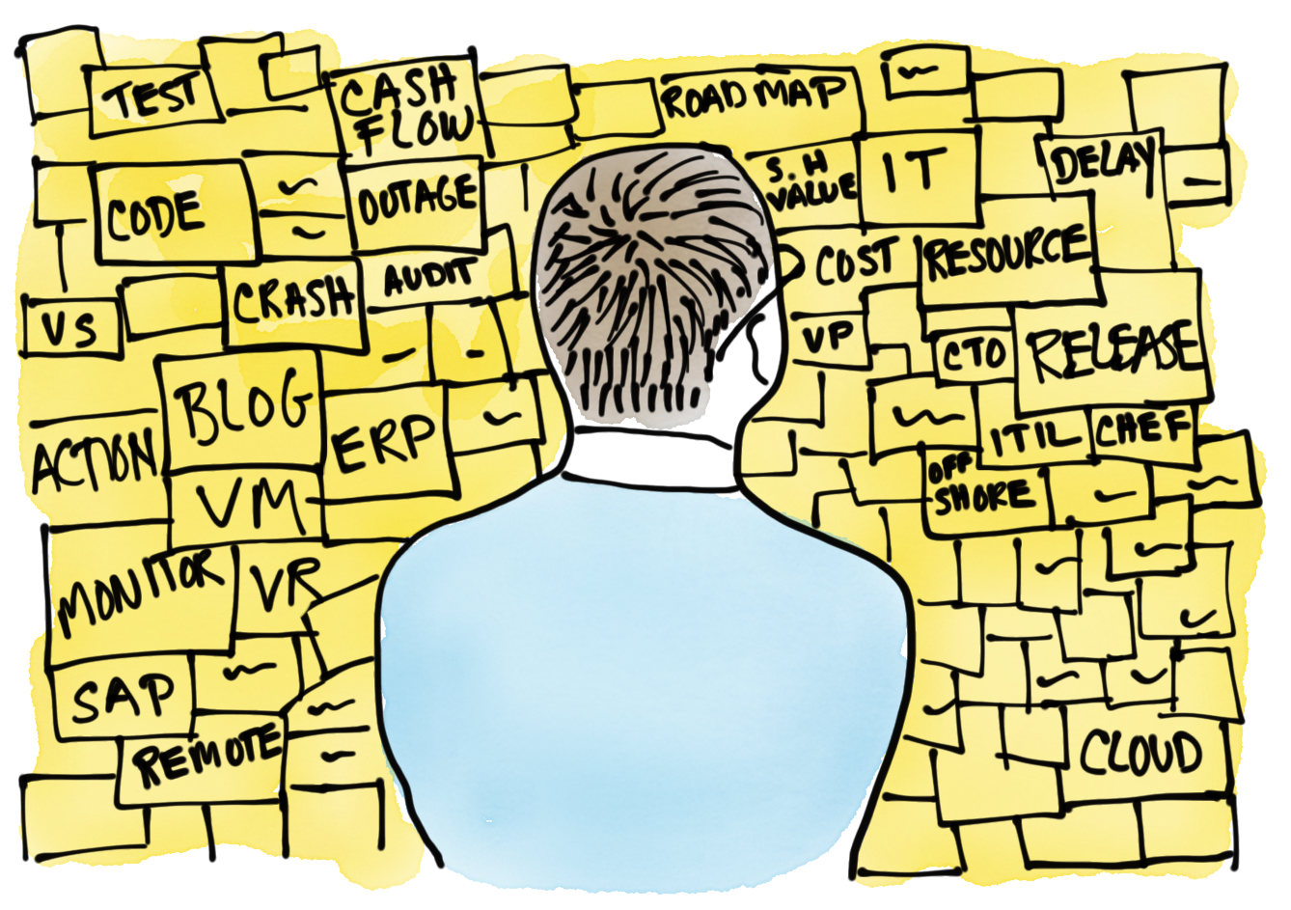
#2 conflicting priorities
Notes:
Competing requests are a major culprit behind WIP overload. When you hear, “My project is more important than that project, you know that priorities are unclear.” 33 projects all happening at the same time, that compete for people’s attention & same resources blocks FLOW, increases partially completed work. Everything cannot be the top priority. This is where clear prioritization policies come into play.

Slide 22
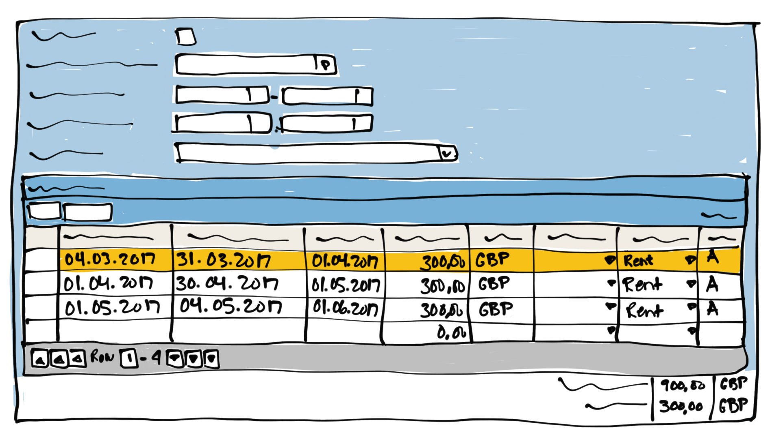
Anticipate conflicting priorities
End-of-month invoicing competes with entering payables and responding to customer account upgrade requests.
For time sensitive, cadence-driven work, give other work a lower priority.
Notes:
Take an accounting team, for ex. Tasks such as end-of-month invoicing (so sales teams can meet their monthly quotas) & getting expense reports to payroll (so employees can be reimbursed), compete with other work - entering payables & responding to customer account upgrade requests.
For cadence-driven work, whether it’s end-of-month invoicing, or quarterly business reviews, or annual security audits, recognize that other work will need to have a lower priority at that time.

Slide 23
HOW to unmask conflicting priorities
To do
doing
validate
done
Expedites and
Unplanned
Cadence
work
₃₀
₃₀
Business
requests
Team
improvements
_{X}
Notes:
ONE way (there’s others, constrained time) that the accounting depart or any other team can bring viz to ongoing cnflctng priorities.
Create a card type specifically for cadence-driven or time sensitive work & put due date on them.
Then looking at this Kanban board you can see what’s competing with each other. Expedite running thru. 2 date driven things running thru the cadence lane. There’s ongoing biz requests. And a couple of team improvements going on. One of them blocked w/ red X b/c the team is working on the other stuff. Hopefully this would provoke a convo on priorities. Something’s prolly got to give here. The idea is to makes prioritization policies explicit. Otherwise how made? By the loudest? HIPPOpinion? CoD? This kind of design sets you up for a honest, respectful convo abt teams workload and brings viz that otherwise wouldn’t notice.

Slide 24
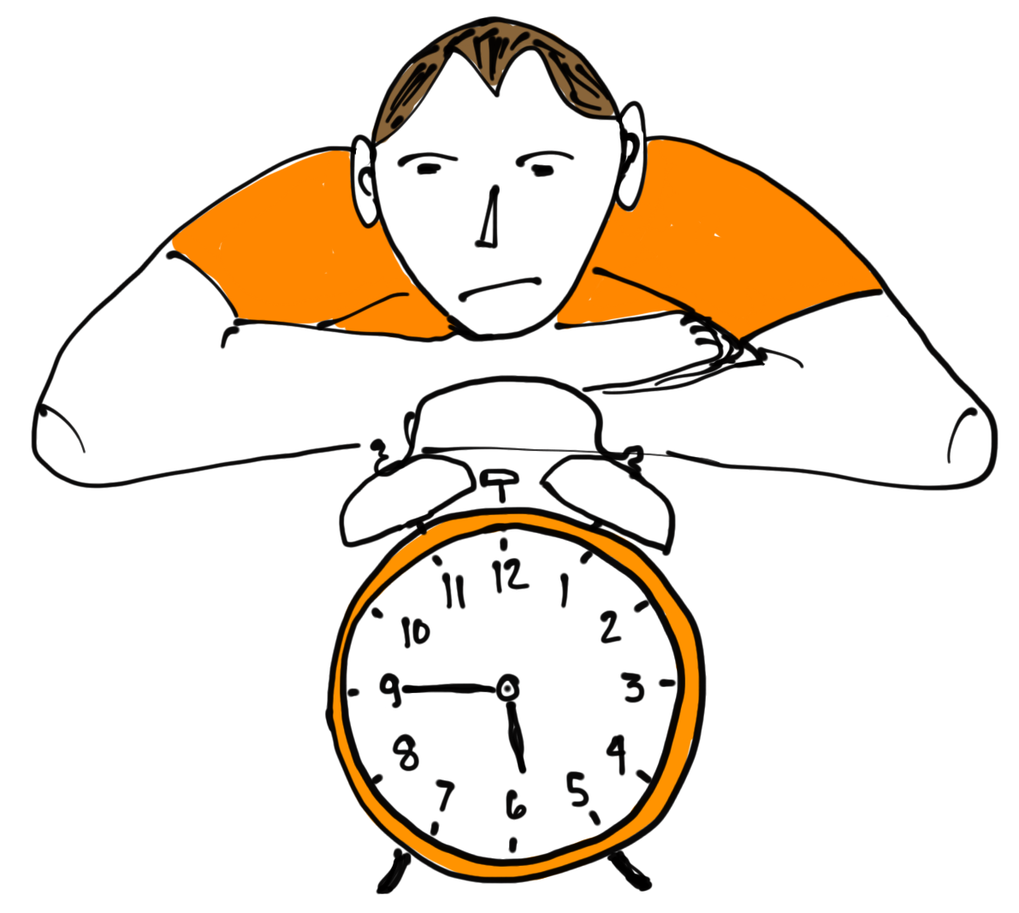
#3 dependencies
Dependencies affect almost everyone.
We work in webs of interdependencies
https://medium.com/netflix-techblog/towards-true-continuous-integration-distributed-repositories-and-dependencies-2a2e3108c051
Notes:
Dependencies affect almost everyone. The marketing editorial director waits on an author to finish writing a blog post so she can do the copy editing.
The social media director waits on the editorial director in order to promote the post. The data analyst waits on the social media director to post the blog so she can look at trends & create metrics. The reality is that we work in webs of interdependencies. If not on people, then on architecture.

Slide 25
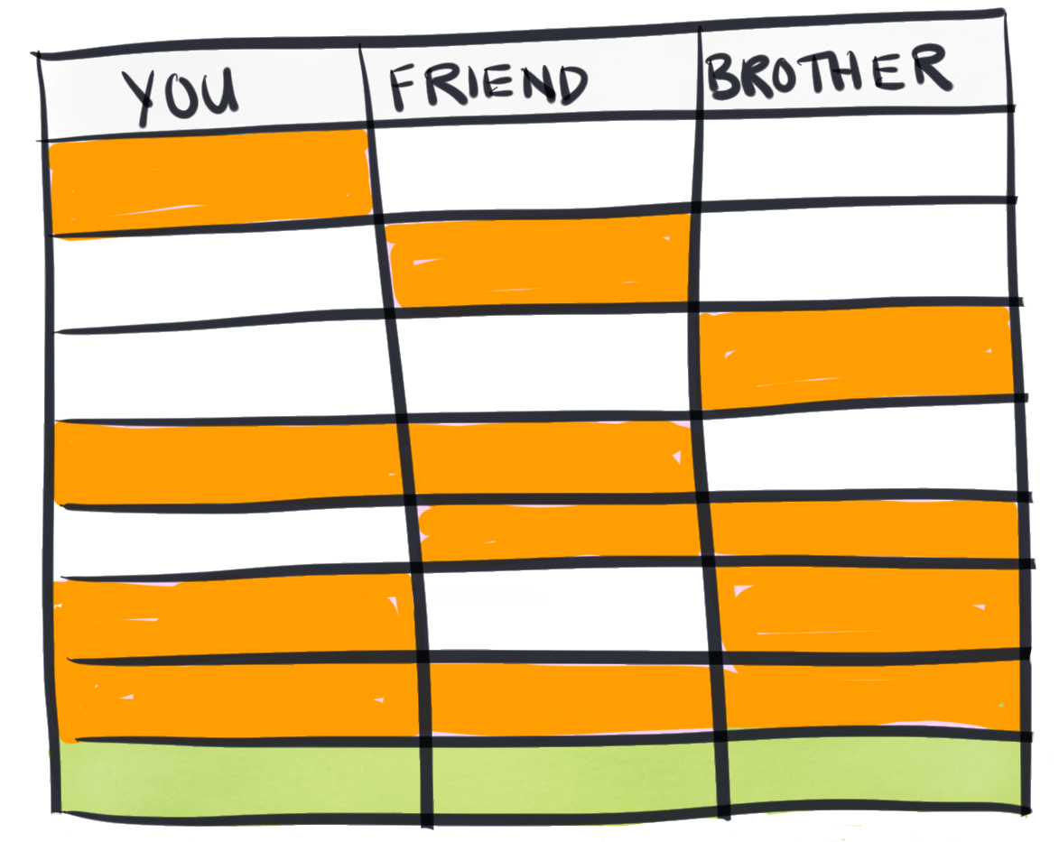
Expect dependencies
Dependencies are
Asymmetrical in their impact.
“Every dependency doubles your chance of being delayed and late.” Troy Magennis
Notes:
To demonstrate how dependencies create WIP overload, let’s image you go out to dinner w/ a friend & their brother to a fine dining rest. Your ea leav fr diff working places independently. The restaurant won’t seat you until everyone arrives.
There are 8 possible outcomes that everyone will arrive on time. Chart that out – you can be on time & your friend….
With 3 dependencies, it’s not a 33% prob you won’t be seated for dinner on time. It’s 87%. There’s only a 1 in 8 chance – it’s 7/8 more likely one of the other outcomes will occur. Dependencies are Asymmetrical in their impact and that’s why
“Every dependency doubles your chance of being delayed & late.” Troy Magennis
And why it’s so important to bring visibility to dependencies.
A friend of mine works for a company with $23 billion in yearly revenue where Product Team X deployed a component that broke Team Y’s product. And now Team Y’s customers have to fork out $5 million for the new Y part. This is on top of the $10 million that they just paid to buy a new X part because the old X part was at end of life and was no longer supported. This company has a major PR disaster on their hands. They are losing significant market share because the two Product teams didn’t talk to each other. Team Y had zero visibility into Team X’s decision to release a new version of software that Team Y’s product was dependent on. It’s very expensive when teams are unaware of mutually critical information.
Check out Netflix article on how their experimenting with dependencies by asking the Q: “Can we provide engineers at Netflix the benefits of a monorepo and still maintaining the flexibility of distributed repositories?”
https://medium.com/netflix-techblog/towards-true-continuous-integration-distributed-repositories-and-dependencies-2a2e3108c051

Slide 26
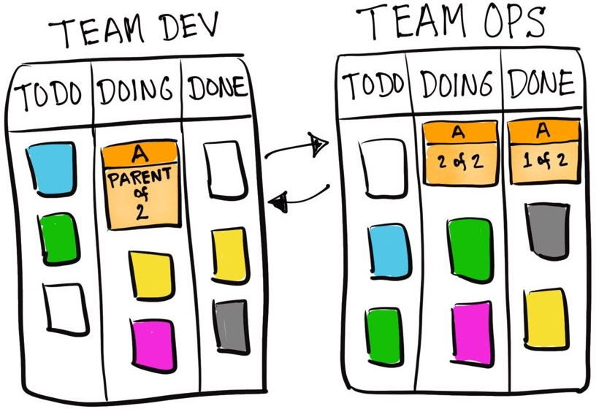
HOW TO UNMASK DEPENDENCIES
Notes:
Here’s a way to bring visibility to dependencies across diff teams. In this ex, there’s a parent card on t/ Team DEV board & it’s dependent on 2 cards that live onTeam Ops board. Headers to help others see the connection between the cards. You can also use tags. The guidance here is to find a way to visualize handoffs of work between teams b/c it can be very expensive when teams are mutually unaware of critical information.
It can also give downstream teams a heads up on potential issues that are coming their way.

Slide 27
Next step: take charge of WIP
Tips to keep expensive business value flowing
If you don’t use WIP limits, start!
Let WIP limits be a creative friendly constraint
Limit WIP to the teams capacity
Consider setting WIP limits that reflect current reality
Notes:
In order to go deeper to get more out of Kanban, two Kanban practices are essential.
1. Making work visible.
2. limiting work in progress. Limiting WIP happens by setting & adhering to WIP limits. A WIP limit is number work items the team believes they should stay at or below. If the team has a WIP limit of 10 & they are already at 10, then, their focus is gonna be completing 1 of those ten before pulling in more work. WIP limits intentionally insert creative tension into system – it’s the constraint that makes Kanban a true pull system. A pull system w/ appropriate WIP limits can’t be overloaded. Think of WIP limit is a friendly constraint - it gives ppl permission to say, ooh – sry, I can’t take that request on right now. I’m full. The WIP limit is what prevents the overload. It’s how to maintain a sustainably smooth and fast FLOW.
So - If you don’t use WIP limits, start! Ignoring them puts you at a disadvantage.

Slide 28
WIP limits intentionally insert tension
Notes:
There are many ways to set WIP limits. I’m going to tell you my favorite way, which is different than what most Lean coaches say.
Instead of spending a bunch of time figuring out what your WIP limits should be, just set them to how many items the team is currently working on.
And then stand back, and ask the question, does it make sense? Usually, teams are working on way way too much. Here, there’s 98 things in validate. Does that make sense? No! next step - adjust t/ WIP limit lower. At this point, It doesn’t really matter how much lower. Just lower. 80 is better than 98. Then after a bit, ask Q again, does this make sense? Is work flowing or getting stuck? If work is getting stuck, then lower the limit again and keep lowering it until you achieve a good FLOW.
This board shows WIP limits at the top of each column, but they don’t have to be there. There’s no rule that says where they need to be.

Slide 29
Consider WIP limits by work type
study
doing
validate
done
Silver Bullet
(1)
Team
improvements
(3)
----→£----→£-----→£---→
Business requests
(5)
Notes:
Sometimes it’s easier to use WIP limits w/ horizontal lanes. The nice thgn abt this way shows that t/ team can always have at least 3 improvements going at 1 time. Also, a way to have a convo w/ the boss about, hey, can we have just 1 silver bullet at a time? Looking at work on t/ board in terms of value can help ppl prioritize * work to get t/ highest pri delivered.
Sometimes you do go over your WIP limit – like here w/ Biz requests. WIP 5, but 8. If you never hit your WIP limit, it’s not doing it’s job to encourage you to improve. If you always hit your WIP limit, you’re likely to ignore it.

Slide 30
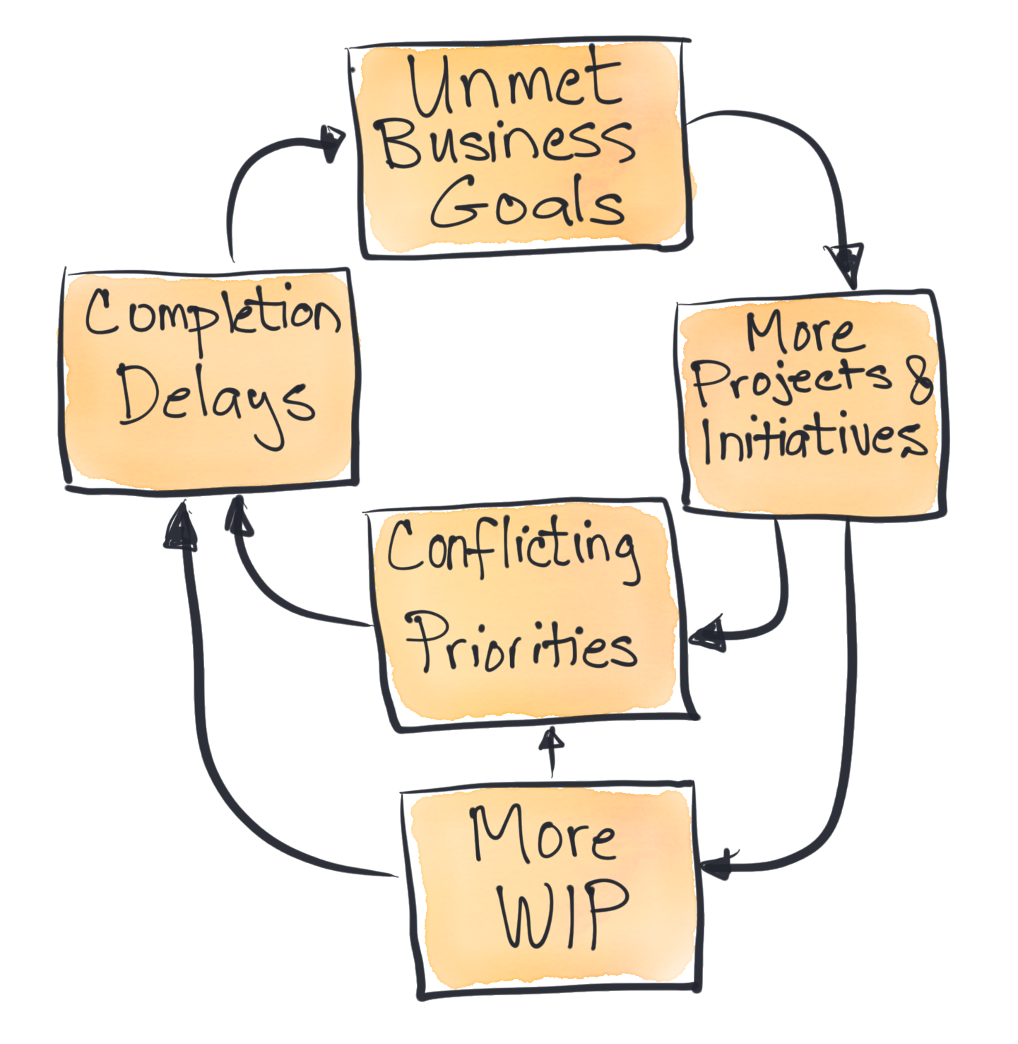
Limit WIP to Find Problems
Partially completed work results in unmet value.
Remove barriers of too much WIP,
so people can deliver some value before starting something new.
Notes:
Keep in mind that partially completed work results in unmet biz value.
1 way to become more predictable to meet biz goals, is to limit WIP to t/ team’s capacity.

Slide 31
Make Work Visible to improve the Flow of value
Make work visible to unmask the overload
Limit WIP to enable smooth Flow
Lose the mask
Notes:
To sum up, In order to reduce the overload, think about using a pull system like Kanban, to help make your work visible. In this way can you shine a light on problems so that you can do something about them. I hope I’ve provided w/ some tactical ways to Limit your WIP so you can deliver expensive biz value quickly. As leaders, please consider your positional power when you ask people to do stuff. Know that they want to say yes. Bottom line: MWV & Lose the mask!

Slide 32
TO RECEIVE THE FOLLOWING:
A copy of this presentation
A copy of the LeanKit Lean Business report
A Kanban roadmap e-book to help you dive into the deep
Updates on my upcoming book, Making Work Visible
Just pick up your phone and send an email to: dominica@leankit.com
Subject: FLOW

Slide 33
Here are the problems that still remain
People take on more work than they have capacity to do.
As leaders, please consider your positional power when you ask people to do stuff. Know that they will usually say yes, which often overloads them, and their teams, and slows the flow of delivering business value.

Slide 34


